Slide 1

Motivation

Slide 2
This Week
No assignments due this week
Discussion 1 and Team Project 1 are available on iCollege
TBA Reading for Week 3-5: Commitment (Chapter 3 of textbook)
Quiz and team charter points will be available next week
Next synchronous meeting (Feb 18th): be ready to negotiate!

Slide 3
PART 1
Why are people motivated?

Slide 4
Your Perfect Job!
If there were such a thing as a perfect job for you, where you are motivated and productive…
  What would it have?
  What would it be like to work that job?
  How would you feel?

Slide 5

Common Motivators
Being rewarded
Being involved
Being challenged
Being interested
Making someone happy
Being encouraged
Having a purpose
Being special
Increasing reputation
Being respected
Being able to prove I could do it
Knowing results will be lasting

Slide 6

What is Motivation??
Variations in
  Intensity
  Persistence
  Quality
  Direction
  of ongoing behavior
Motivation is not performance!

Slide 7
PART 2
What do we know
about motivation?

Slide 8
VIE Theory
Instrumentality
The perceived relationship between performance and outcome
Valence
Expectancy
The strength of preference of an outcome
The belief that a behavior will lead to a performance

Slide 10
Valence
Expectancy
Desire to Perform
Effort
Instrumentality

Slide 11
Need Theories
Needs can motivate individual behavior
  Biological or instinctive
  Drives
People behave as they do to satisfy needs

Slide 12
Maslow’s Hierarchy of Needs
Self-Actualization
Esteem
Social
Safety
Physiological
Higher Order
Lower Order

Slide 13
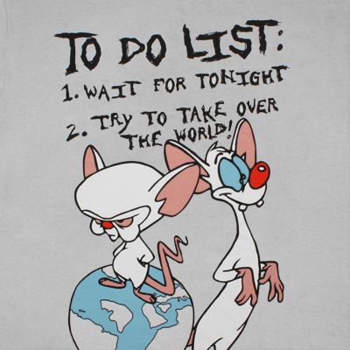
McClelland’s Needs
Need for Achievement
Need for Affiliation
Need for Power

Slide 14
Needs
Valence
Expectancy
Desire to Perform
Effort
Instrumentality

Slide 15

Work Design Theory
Motivation comes from the work environment
  Instead of the people

Slide 16

Job Characteristics
Skill variety
Task identity
Task significance
Autonomy
Task feedback

Slide 17
Reinforcement Theory
People are motivated to engage in behaviors because of rewards associated with these behaviors
People are motivated to avoid behaviors because of punishment associated with these behaviors

Slide 18
Needs
Valence
Expectancy
Desire to Perform
Effort
Instrumentality
Reinforcement

Slide 19
Self-Efficacy Theory
A belief in one’s capability to perform a task or reach a goal
  Different than self-esteem

Slide 20
How to Increase
Self-Efficacy
Mastery experience
Modeling
Social persuasion
Physiological states

Slide 21
Self-Fulfilling Prophecy

Slide 22
Leaders
Needs
Valence
Expectancy
Desire to Perform
Effort
Performance
Instrumentality
Reinforcement

Slide 23
Goal-Setting Theory
A goal is a motivational force
Why does it matter?
Direction
Intensity
Persistence
Strategies
Feedback is also important

Slide 24

Self-Regulation
People collect information about their behaviors in the pursuit of their goals
People adjust their behavior based on the information to enhance likelihood of attaining their goals

Slide 25
How to set goals?
How do you set goals for others as a leader?
      Goal acceptance
      Goal commitment

Slide 26
Leader
Needs
Valence
Expectancy
Ability
Desire to Perform
Effort
Performance
Instrumentality
Goal Setting
Reinforcement

Slide 27
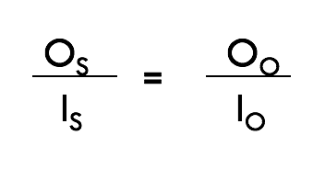
Equity Theory
Process by which people determine whether they have received fair treatment
Principle of social comparison

Slide 28
Two Types of Inequity
Underpayment
Overpayment
A state of tension caused by perceived inequity as motivation

Slide 30
Model of Motivation and Performance
Needs
Leader
Valence
Expectancy
Ability
Desire to Perform
Effort
Performance
Satisfaction
Instrumentality
Goal Setting
Equity
Reinforcement

Slide 31
Two Big Questions
How about procrastination?
  You are not lazy!
What can be wrong with goals?
  Hint: Unintended consequences

